Slide 1
Reducing Ontario Vehicle Traffic
AN IN-DEPTH ANALYSIS INTO ONTARIO COMMERCIAL VEHICLE TRAFFIC IN 2006
A Presentation to the Ministry of Transportation Ontario Region
08-Aug-2023

Slide 2
Summary
815.4
2333
65,008
57,096
Average of Total Vehicles
Average of other Vehicles
On Highway 400
On highway 401
On Friday
In Central Ontario Region
Traffic by Total Vehicle on Road was higher; 815.4
Traffic by other Vehicles was at peak; 2333
On Highway 400
On Highway 401
Between King & Kettleby Rd during 5-6 PM the number was significant; 65,008
Between King & Kettleby Rd during 5-6 PM the number was noticeable; 57,096

Slide 3
Analysis Approach
Problem
3
4
Data Visualization
Congested highways due to vehicle traffic
Used Tableau for making graphs based on various categories
2
5
Objective
Insights
Optimizing MTO Regions Traffic
Made Dashboard to provide insights
1
6
Prep the Data
Recommendations
Used Tableau & Excel to clean the data and exploratory data analysis
Provided recommendations based on analysis and insights

Slide 4
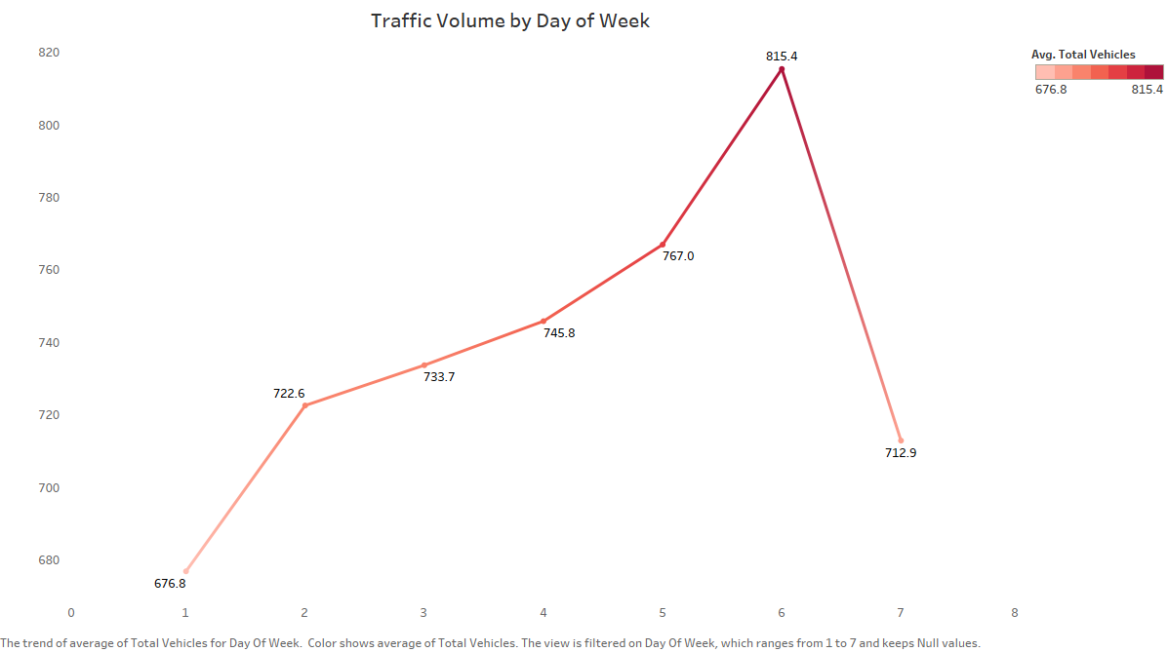
What is the overall traffic volume trend across different days of the week?
Methods
Analyze the day-of-week attribute (ranging from 1 to 7) in the dataset. 1 = Sunday & 7 = Saturday
Aggregate total vehicle counts for each day of the week to determine traffic volume trends.
Analysis
Calculate the average total vehicle counts for each day of the week.
Visualize the trend using a line plot.
Conclusion
Identified higher traffic on weekdays and lower traffic on weekends.
Insights can guide resource allocation and planning for traffic management or service optimization.

Slide 5
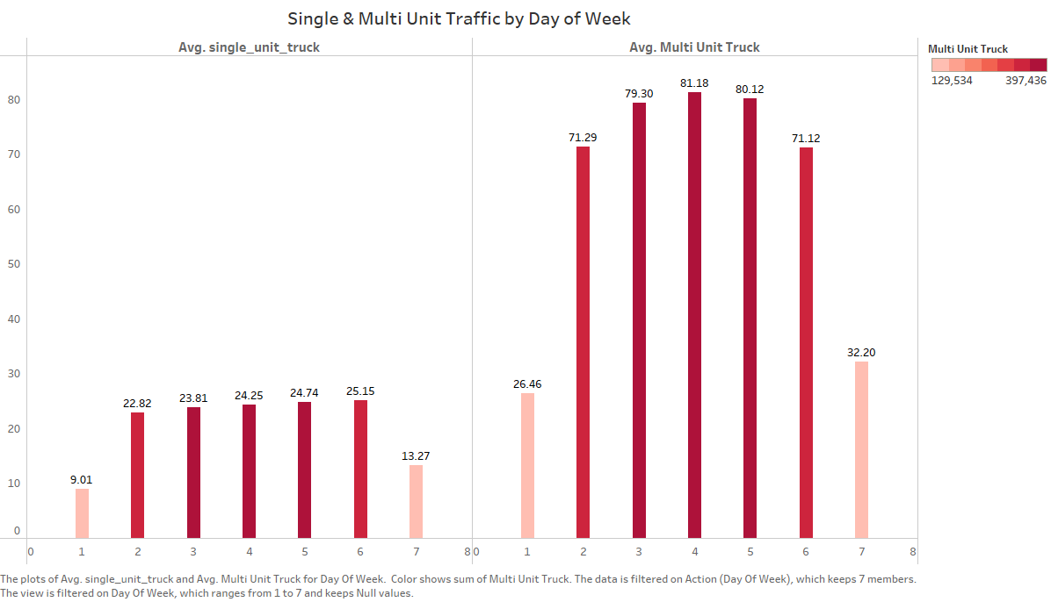
How does single-unit and multi-unit Trucks vary throughout the week?
Methods
Group the dataset by day of the week.
Calculate the average single-unit truck and multi-unit truck counts for each day.
Analysis
Visualize the variations using bar charts, with days of the week on the x-axis and truck counts on the y-axis.
Conclusion
Noticed that the number of multi-unit trucks is greater on weekdays as compared to single-unit trucks.
Insights can guide truck scheduling, resource allocation, and route optimization strategies based on observed variations.

Slide 6
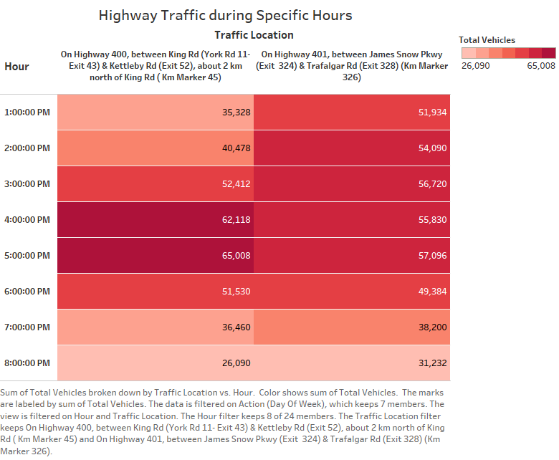
Which highways/locations experience the highest traffic volume during specific hours?
Methods
Filter the dataset for specific hours of interest.
Aggregate the data based on the highway and calculate average traffic volumes.
Analysis
Identify highways with consistently higher average traffic volumes during the specified hours.
Visualize the findings using heatmaps displaying highways and average traffic volumes within the specified hours.
Conclusion
Observed that the period between 4:00 PM and 6:00 PM sees peak traffic volumes on highways 400 and 401.
Insights can aid in traffic management, infrastructure planning, and potential route adjustments to alleviate congestion during those hours.

Slide 7
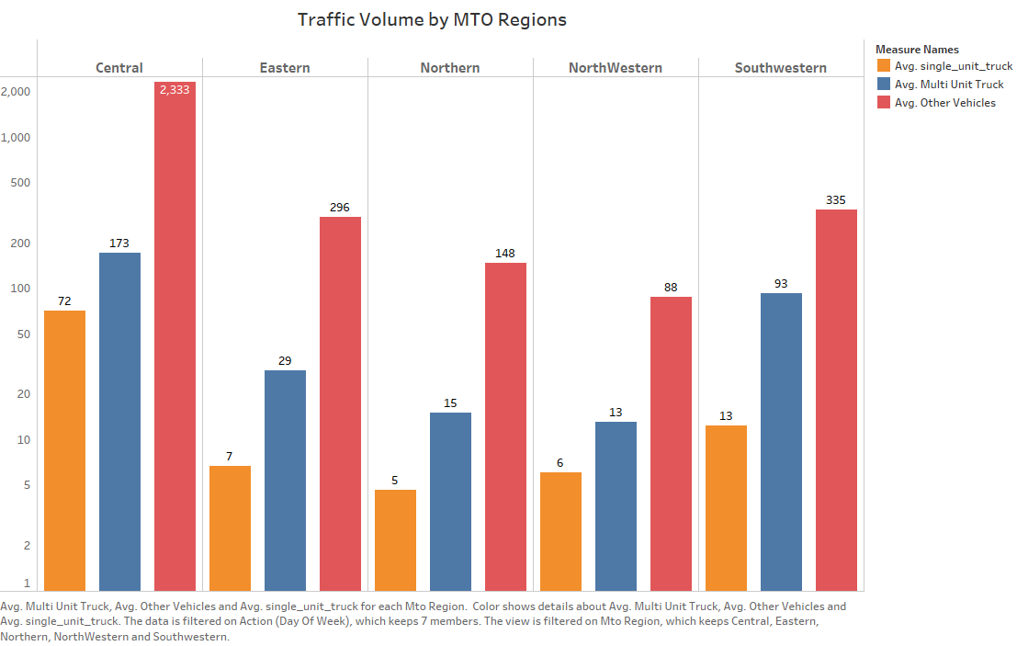
How does different vehicle volume vary across different MTO regions?
Methods
Group the dataset by the Ministry of Transportation of Ontario (MTO) region.
Calculate the average traffic volume (single-unit trucks, multi-unit trucks & other vehicles) for each region.
Analysis
Visualize the variations using bar charts with MTO regions and vehicle types on the x-axis and average traffic volumes on the y-axis.
Conclusion
Identified that the Central MTO region has higher traffic volumes (single-unit trucks, multi-unit trucks & other vehicles).
Gained insights into regional traffic distribution patterns.
This information can inform infrastructure development, resource allocation, and transportation planning efforts in each region.

Slide 8
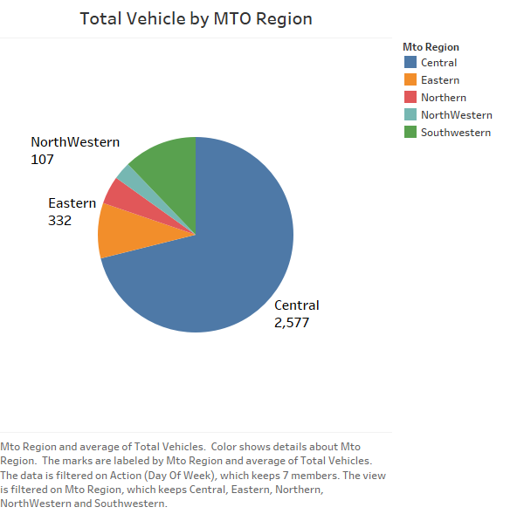
How does the total vehicle volumes vary across different MTO regions?
Methods
Group the dataset by MTO region.
Calculate the sum of total vehicle counts for each region.
Analysis
Visualize the distribution using pie charts, with MTO regions as categories and total vehicle counts as values.
Conclusion
Identified higher total vehicle volumes in the Central Region and comparatively lower volumes in the Northwestern region.
Gained insights into regional traffic intensity and potential transportation challenges.
This can inform infrastructure planning, resource allocation, and traffic management strategies in different regions.

Slide 9
Recommendations
Route Optimization & Scheduling
Improve road capacity
Changes in Vehicle Speed

Slide 10
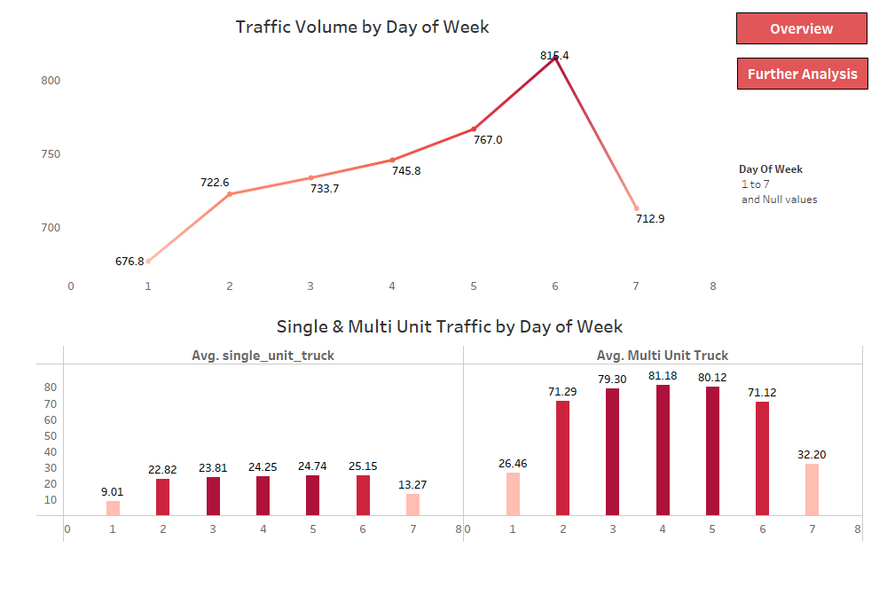
Appendix A1 - Tableau Dashboard (2/3 views)

Slide 11
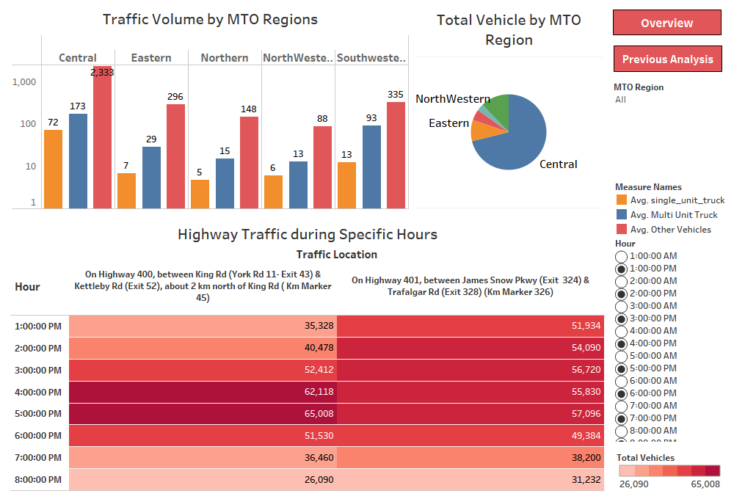
Appendix A2 - Tableau Dashboard (3/3 views)
Link to complete Tableau Dashboard – www.Tableau.com/TrafficAnalysis

